Slide 1

Modernize Virtualize Automize
Windows Server 2016
Shawn Lytle
Logan Monkevicius

Slide 2
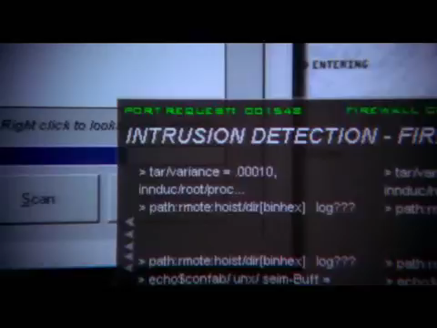

Slide 3

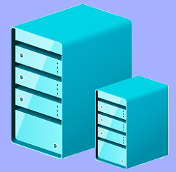

Hyper – V Manager
Key Components
PowerShell
PowerShell ISE

Slide 4
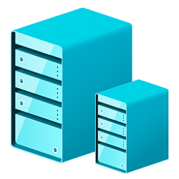

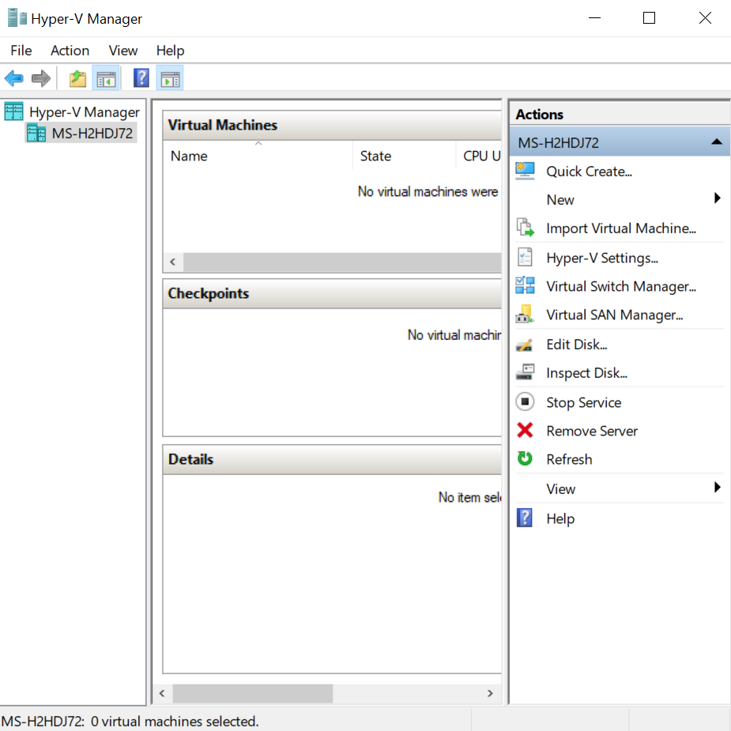
Hyper-V
What is it?
Hyper-V is Microsoft’s hardware virtualization product.
Hyper-V allows you to create and manage virtual machines.
Allows for the creation of many isolated operating systems.
For more information of Hyper-V; please visit https://docs.microsoft.com/en-us/windows-server/virtualization/hyper-v/hyper-v-technology-overview

Slide 5
Hyper – V Manager
Key Components
PowerShell
PowerShell ISE

Slide 6

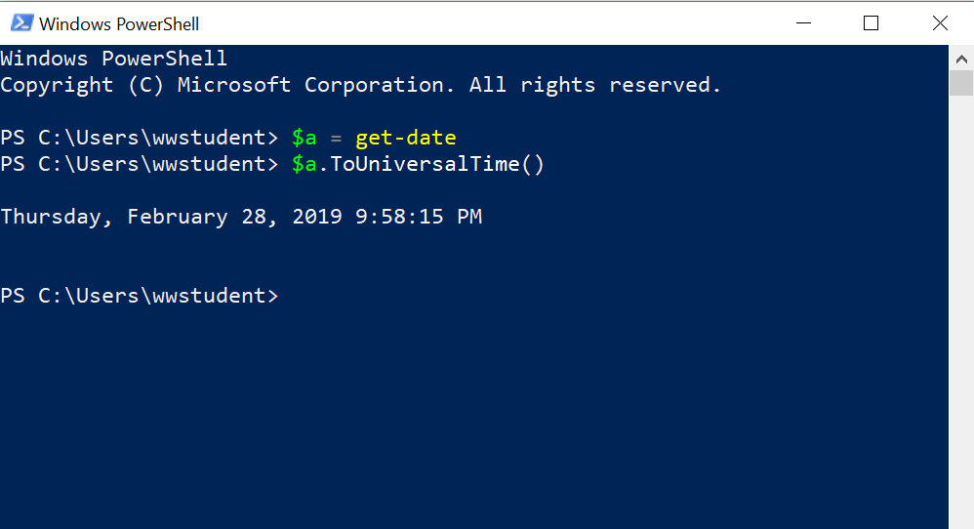
PowerShell
What is it?
PowerShell is a task automation and configuration management framework.
Windows command-line shell designed especially for system administrators.
For more information; please visit https://docs.microsoft.com/en-us/powershell/scripting/getting-started/getting-started-with-windows-powershell?view=powershell-6

Slide 7
Hyper – V Manager
Key Components
PowerShell
PowerShell ISE

Slide 8
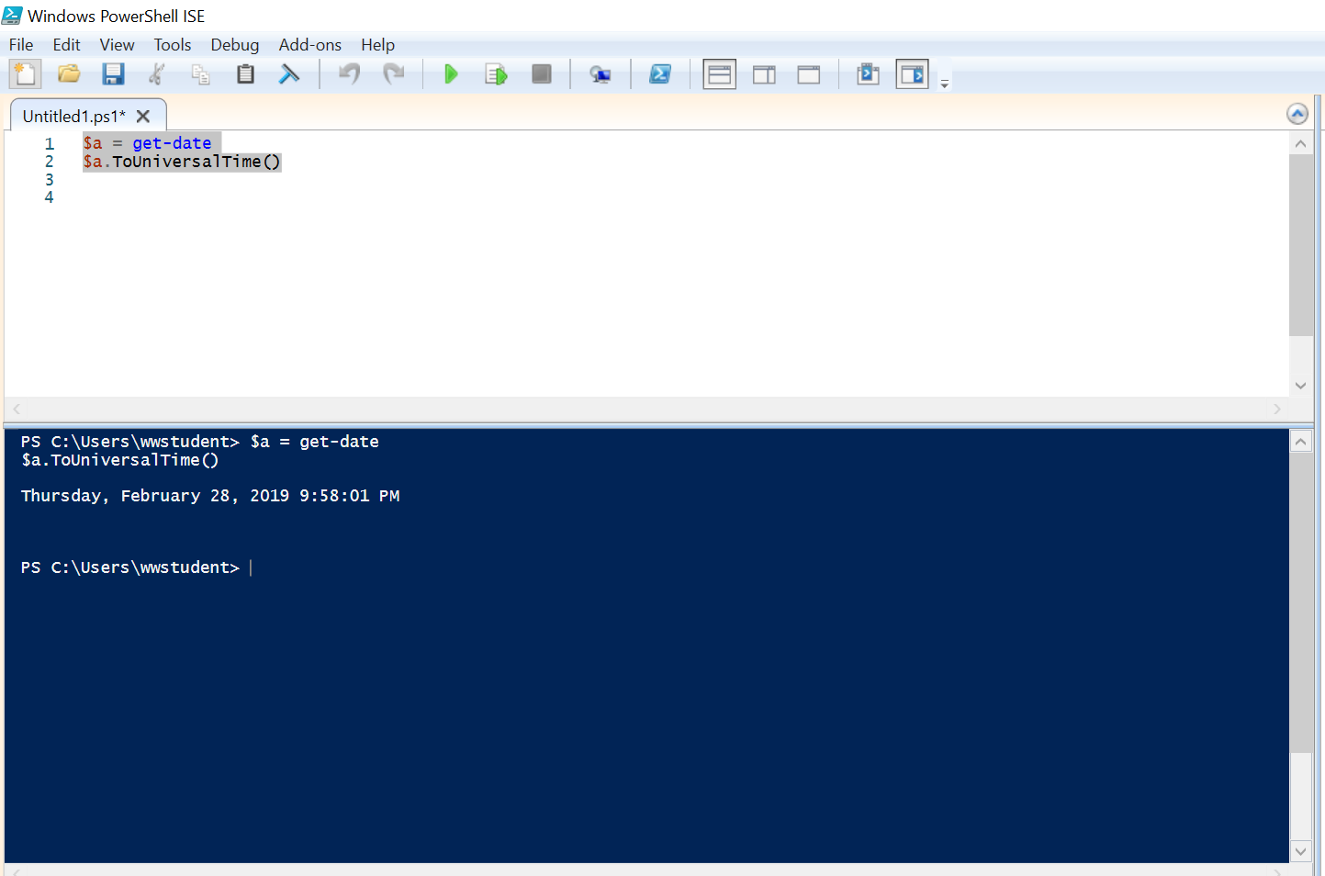
PowerShell ISE
What is it?
Host application for Windows PowerShell.
Run commands and write, test, and debug scripts in a single Windows-based graphic user interface.
For more information; please visit https://docs.microsoft.com/en-us/powershell/scripting/components/ise/introducing-the-windows-powershell-ise?view=powershell-6

Slide 9
1.
The Project
Let’s get started…

Slide 10
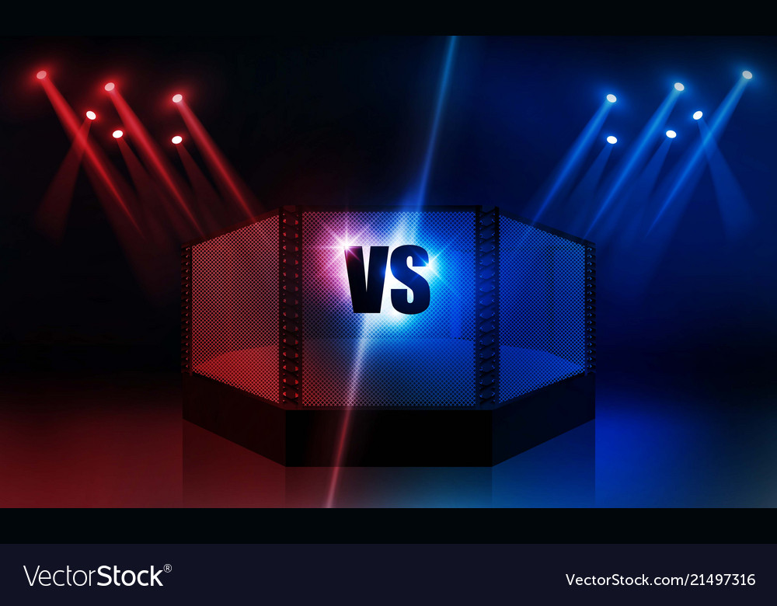




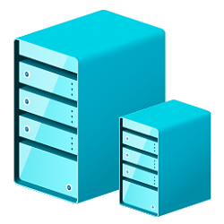

PowerShell
GUI

Slide 11
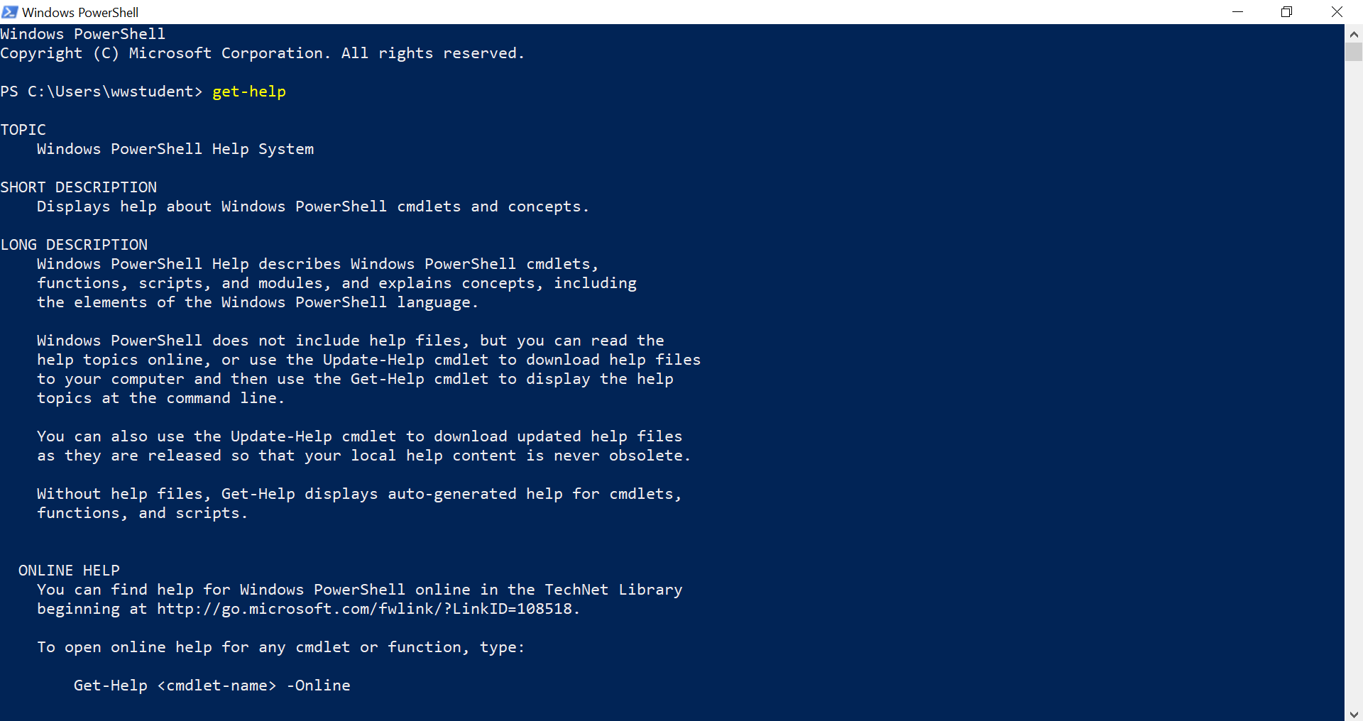

Why work in PowerShell ?
Place your screenshot here
Creating 4 virtual machine’s through a PowerShell script took 17 seconds!
Creating 4 virtual machines through the Hyper-V GUI took 3 minutes and 30 seconds!

Slide 12
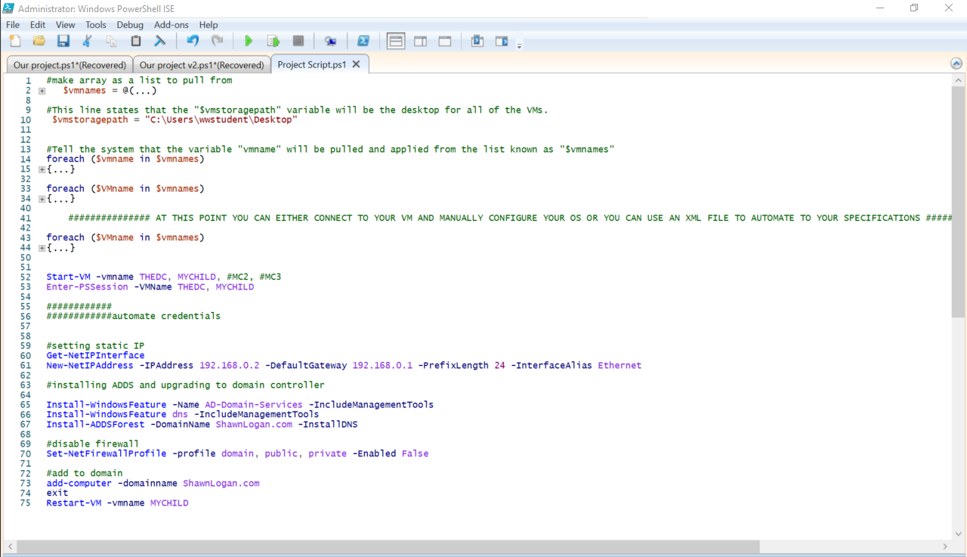
Place your screenshot here
THE
SCRIPT

Slide 13
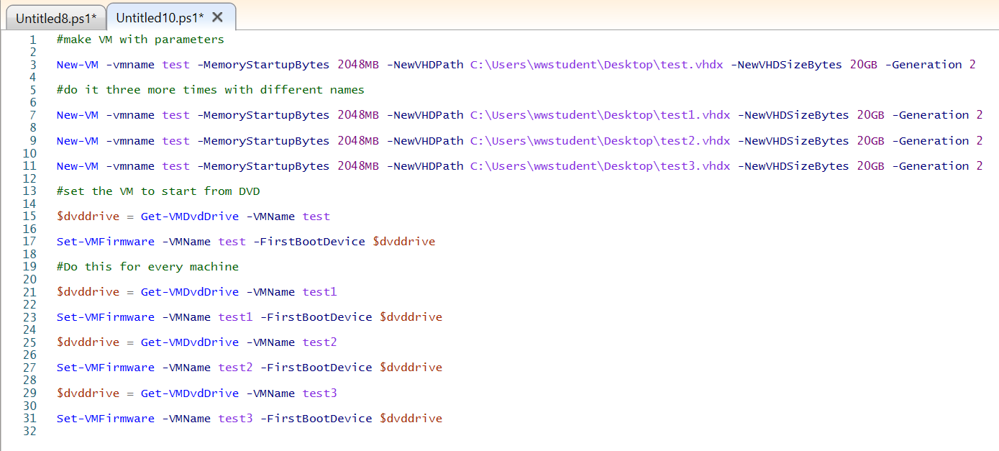
You can insert graphs from Google Sheets

Slide 14
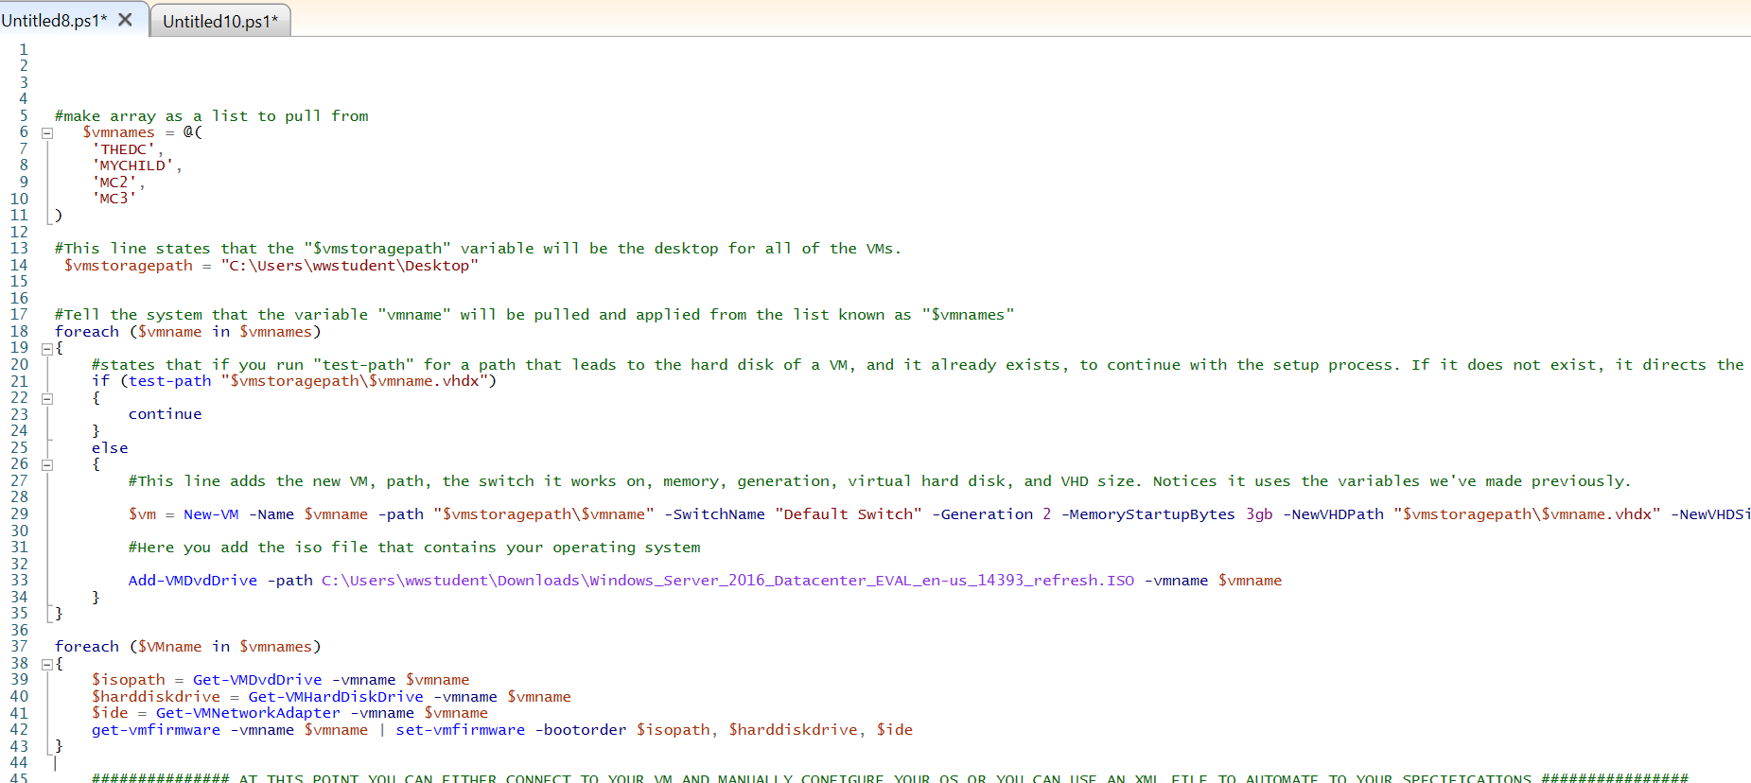
You can insert graphs from Google Sheets

Slide 15
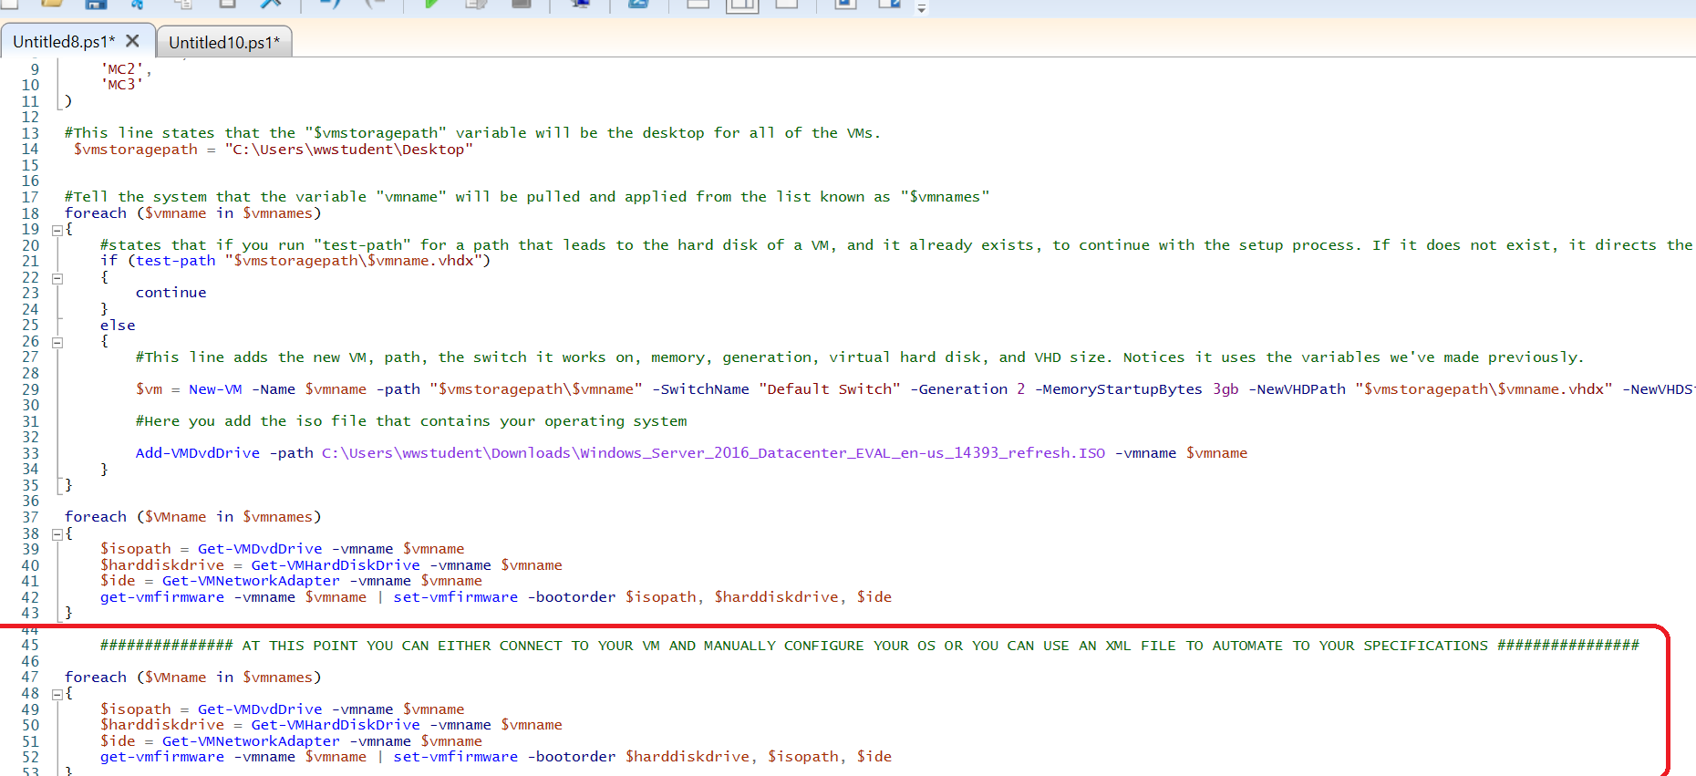
You can insert graphs from Google Sheets

Slide 16
What’sNext ?
Growth Mindset!

Slide 17

Unattended Install
Windows Server 2016 installation can be fully automated by using an unattend.xml file and using PowerShell code.
Unattended installation is a procedure for installing software without user intervention.
For more information; please visit: https://social.technet.microsoft.com/wiki/contents/articles/36609.windows-server-2016-unattended-installation.aspx

Slide 18
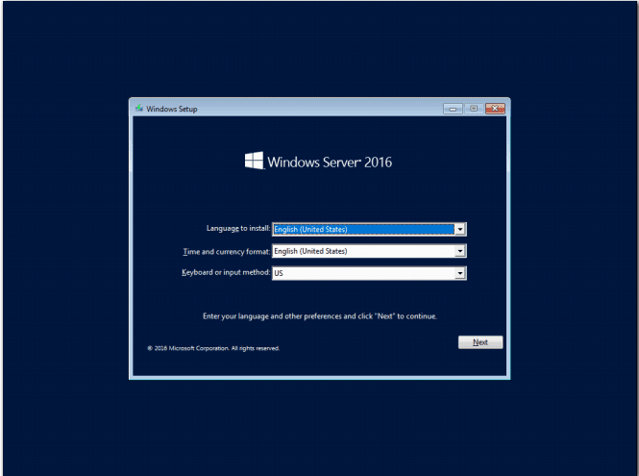


Slide 19

Modernization
Microsoft Azure is an open, flexible, enterprise-grade cloud computing platform.
Everything we just did… can be done in Azure!
For more information; please visit: https://azure.microsoft.com/en-us/overview/what-is-azure/

Slide 20
LET’S REVIEW…
Using Hyper-V manager
Using PowerShell
Created Virtual Machines
Created a Forest
PoSh “For Each” Statements
PoSh Variables

Slide 21

THANKS!
Any questions?

